Slide 1
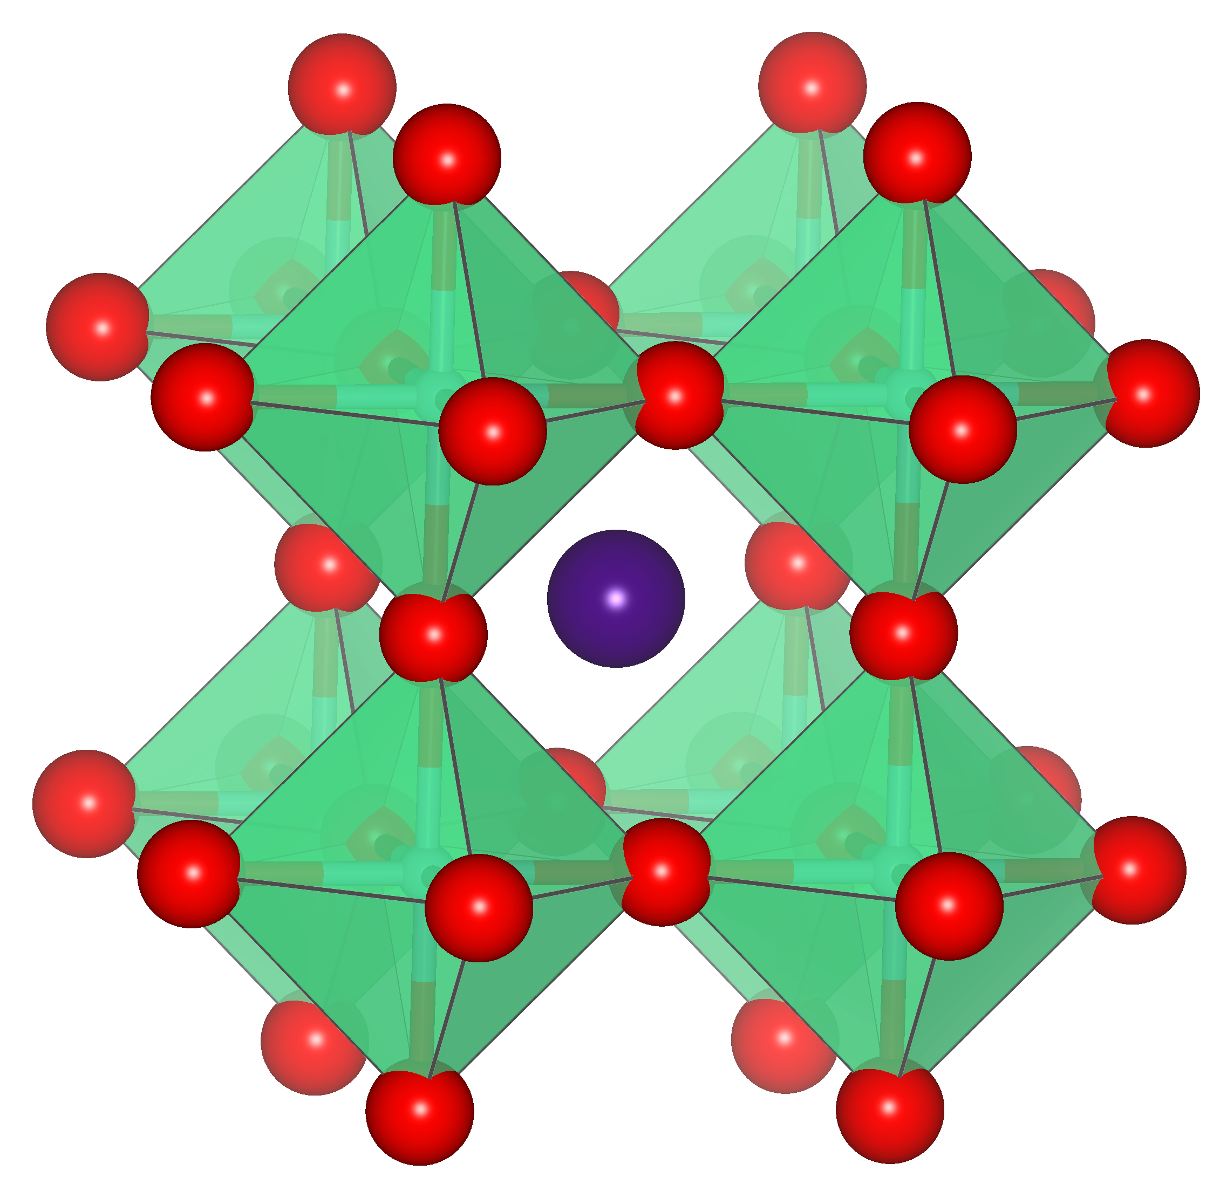
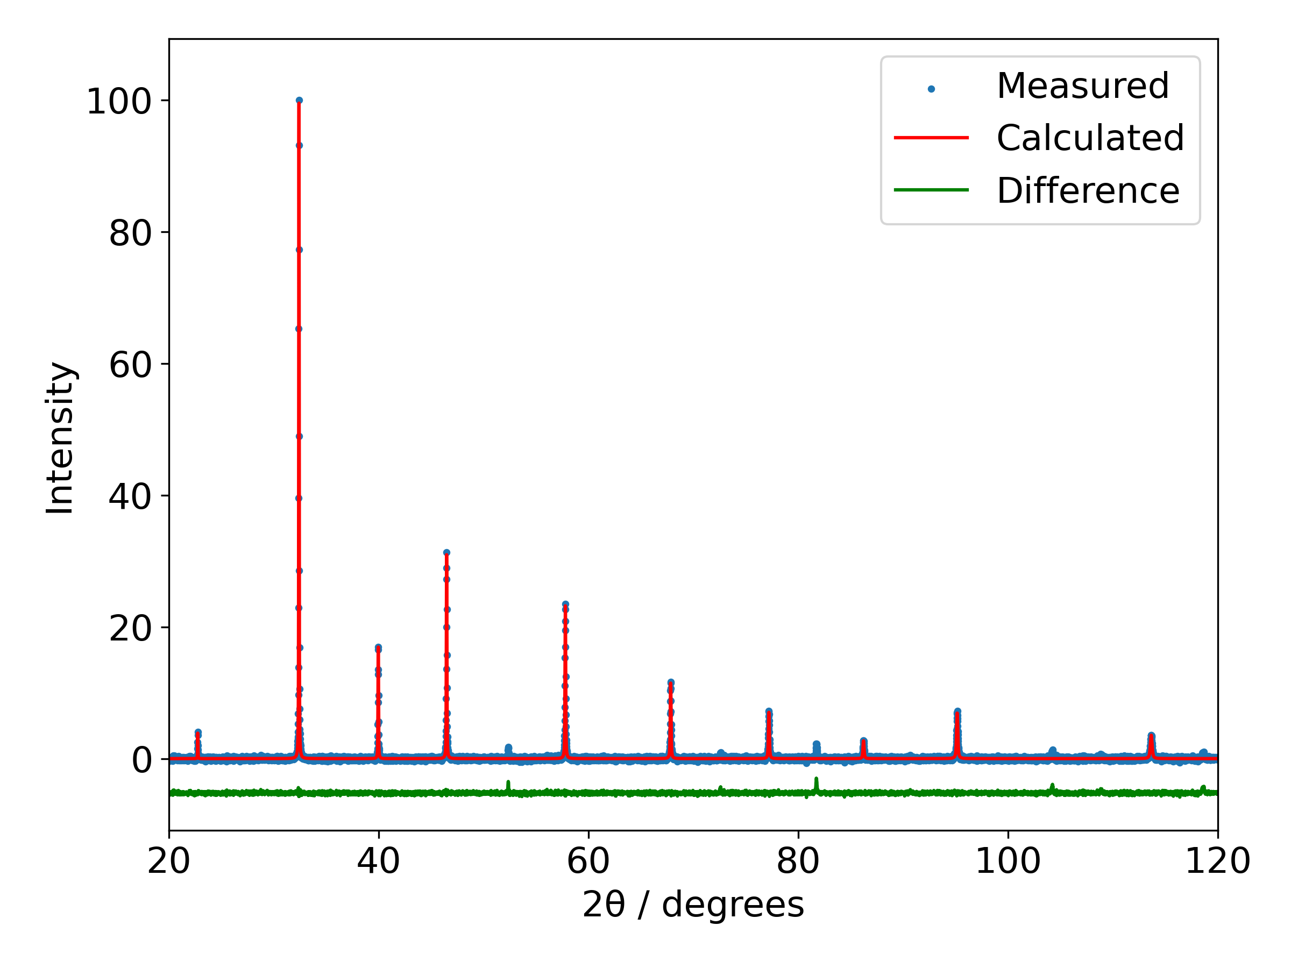



Data and Models of Solid State Structures
https://github.com/rsc-solid-data/data_diffn_crystals

Slide 2
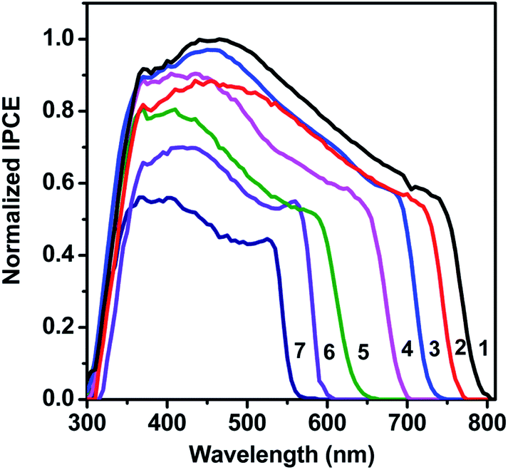

Structure: Foundation of materials “design”
Structure
Properties
Function and application
Solid state structure underpins function in materials, from conductivity to colour.
Representations of solid-state structure are models, not direct observations.
Accurate, truly representative structural models are vital
→ Valid structure-property relationships
S. A. Kulkarni et al., J. Mater. Chem. A, 2014, 2, 9221.
Notes:
S. A. Kulkarni, T. Baikie, P. P. Boix, N. Yantara, N. Mathews and S. Mhaisalkar, Band-gap tuning of lead halide perovskites using a sequential deposition process, J. Mater. Chem. A, 2014, 2, 9221–9225.

Slide 3

Models are everywhere
Assumptions
Observation
Final model
Approximation, prediction
Input
Model
Output

Slide 4
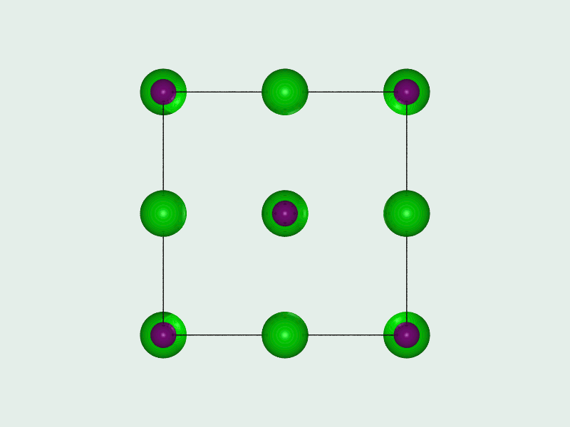
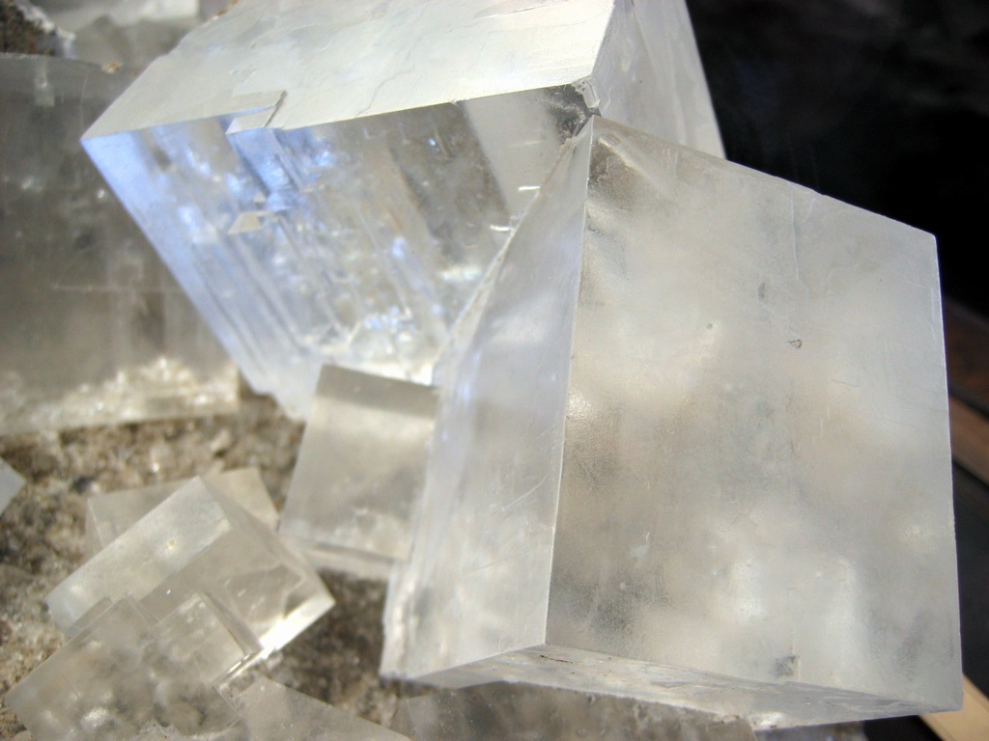
Models are everywhere
Ionic model
Hard spheres, known radii, electrostatic interactions
Crystalline solid
Regular repeat defined by periodic lattice
Crystal structure Approximation of true atomistic arrangement (another model)
Assumptions
Real crystal
Input
Model
Output

Slide 5
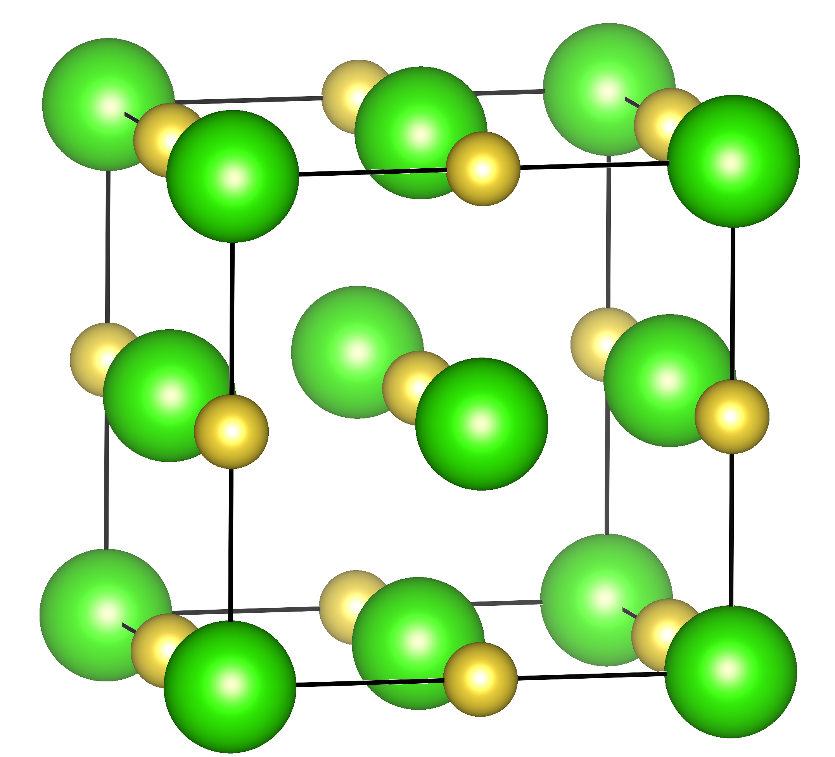
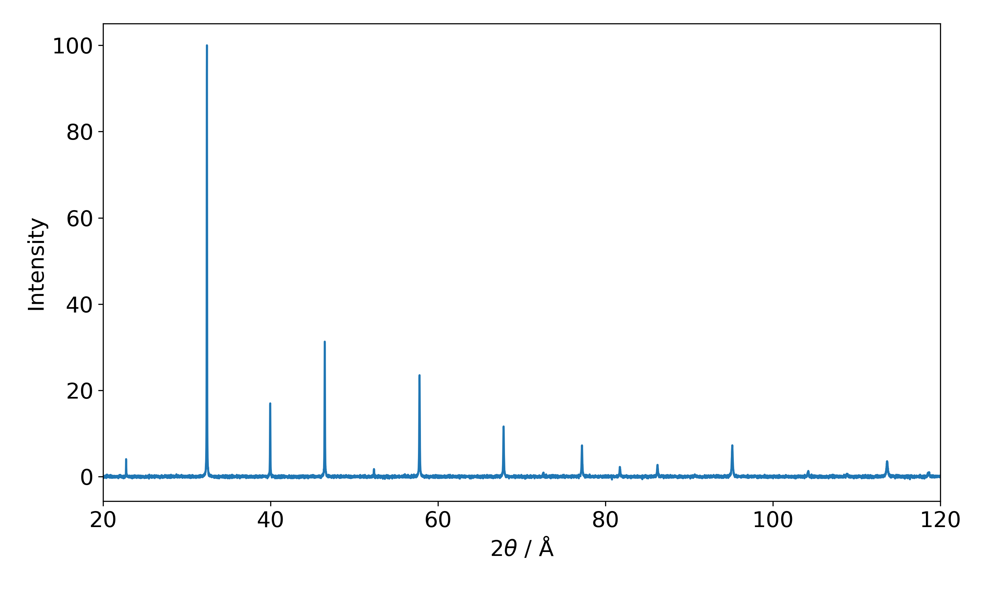



Models are everywhere
e.g.
Data reliability
(sample, measurement, processing…)
Long-range, perfectly ordered structure
Time-averaged “static” structure represents dynamics adequately
Assumptions
Crystal structure
(another model)
Bragg’s law
Intensities
Structure factors
Thermal effects…
Input
Model
Output

Slide 6
Models are everywhere
e.g.
Model reliability
(physically realistic, precision on refined parameters)
Long-range, perfectly ordered structure
Time-averaged “static” structure represents dynamics adequately
Assumptions
Crystal structure
(another model)
Measurable data
XRD
IR
Raman
Properties
Optical
Porosity
Guest affinity
Conduction
Bragg’s law
Intensities
Structure factors
Thermal effects…
Output
Model
Input

Slide 7

Models are everywhere
Assumptions
Observation
Final model
Approximation, prediction
Input
Model
Output

Slide 8
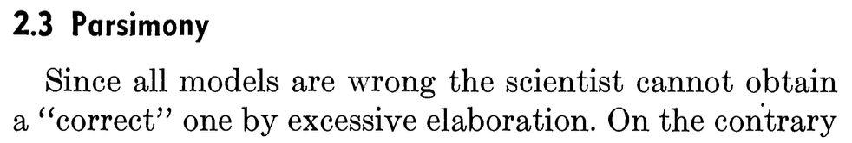
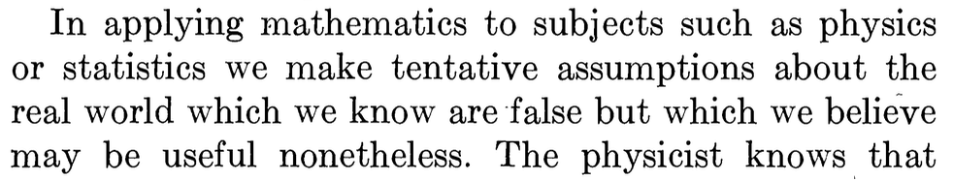
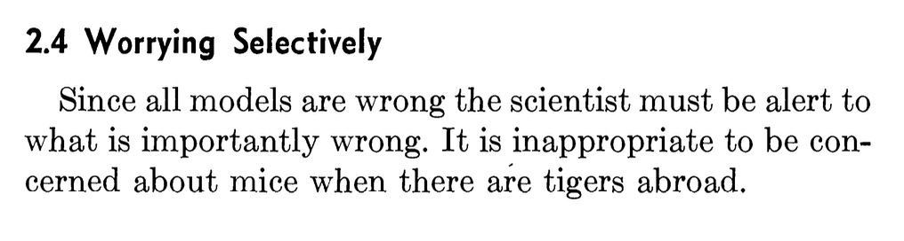
“All models are wrong, but some are useful”
– George E. P. Box
https://en.wikipedia.org/wiki/All_models_are_wrong
G.E.P. Box, Journal of the American Statistical Association, Vol. 71, No. 356. (1976), pp. 791-799.

Slide 9
Crystallography
Modelling crystals

Slide 10
XRD data to structural model
Ionic model
Hard spheres, known radii, electrostatic interactions
Crystalline solid
Regular repeat defined by periodic lattice
Approximation of true atomistic arrangement (another model)
Assumptions
Real crystal
Input
Model
Output

Slide 11
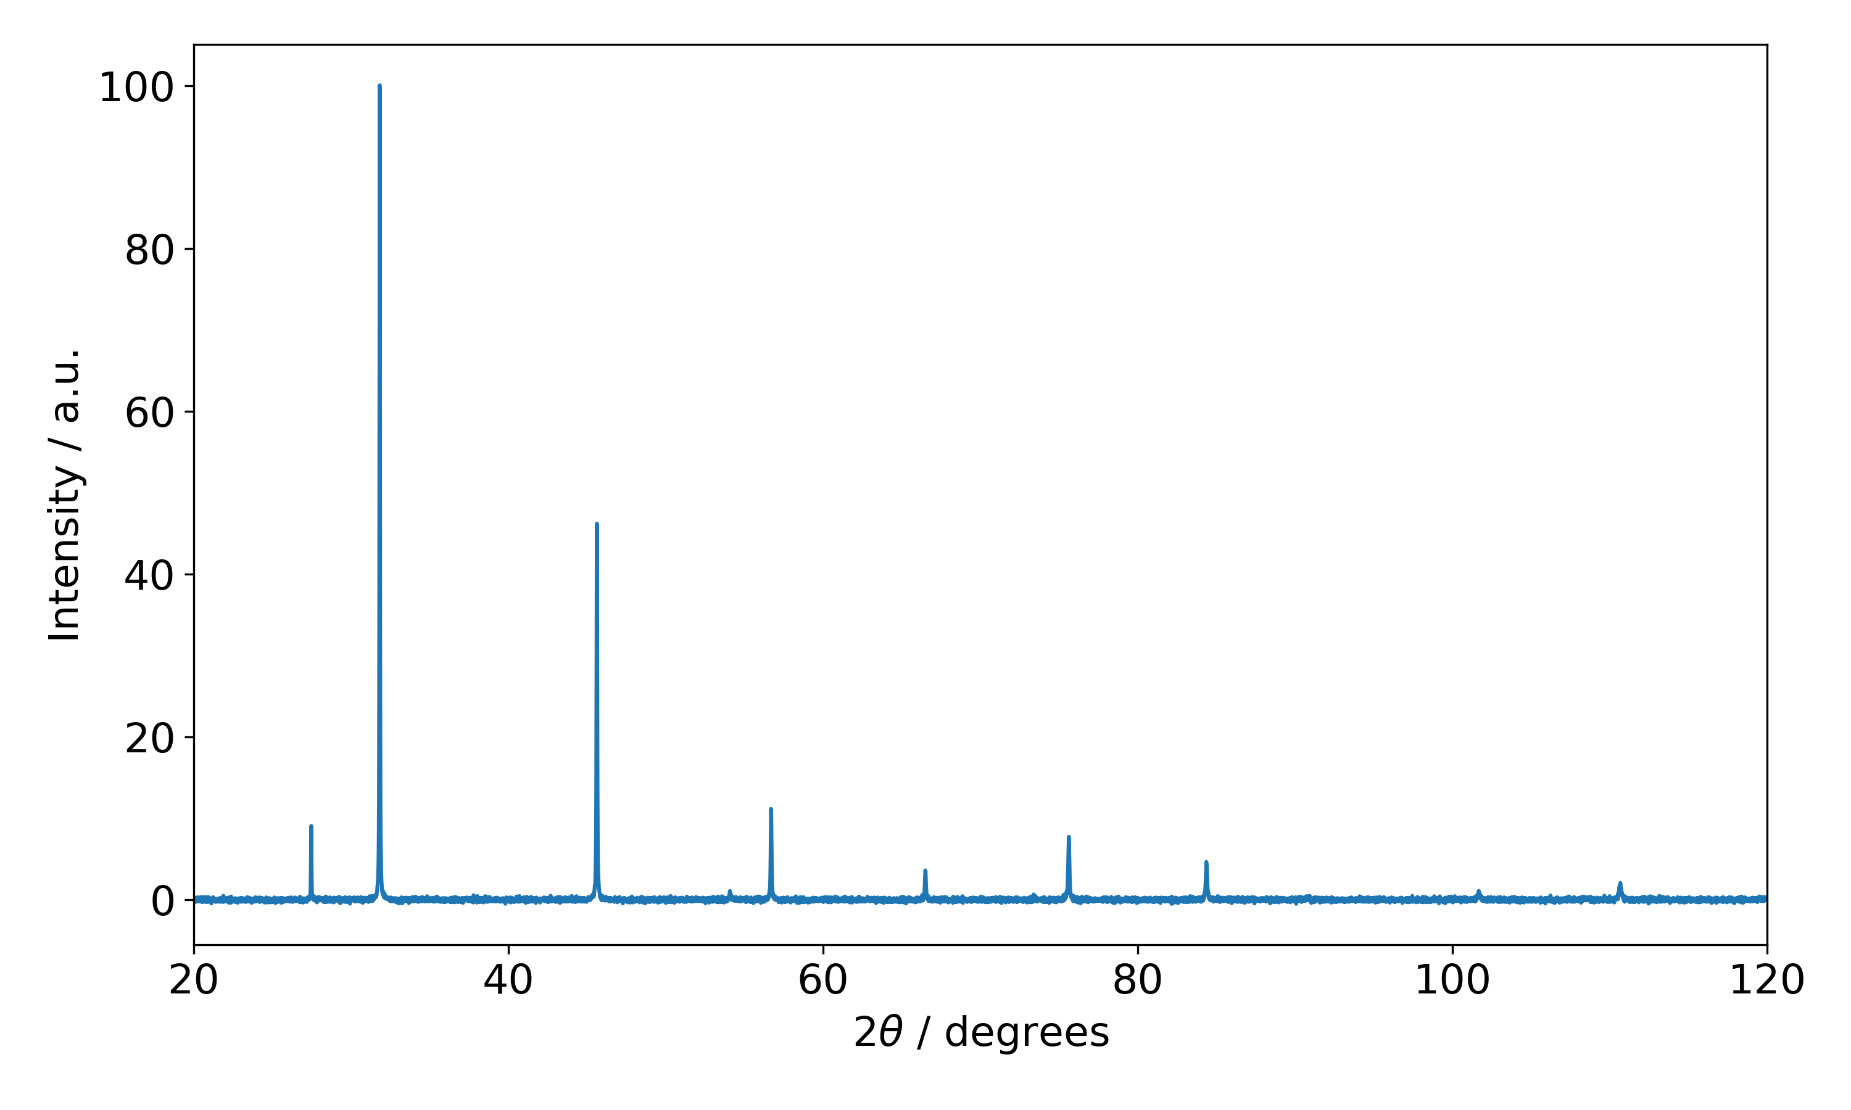
XRD data to structural model
e.g.
Data reliability
(sample, measurement, processing…)
Long-range, perfectly ordered structure
Time-averaged “static” structure represents dynamics adequately
Assumptions
Crystal structure
(another model)
Bragg’s law
Intensities
Structure factors
Thermal effects…
Input
Model
Output

Slide 12
XRD data to structural model
Crystal structure
(another model)
Positions Areas
Widths
Bragg’s law
Intensities
Structure factors
Thermal effects…
Output
Input
Model

Slide 13
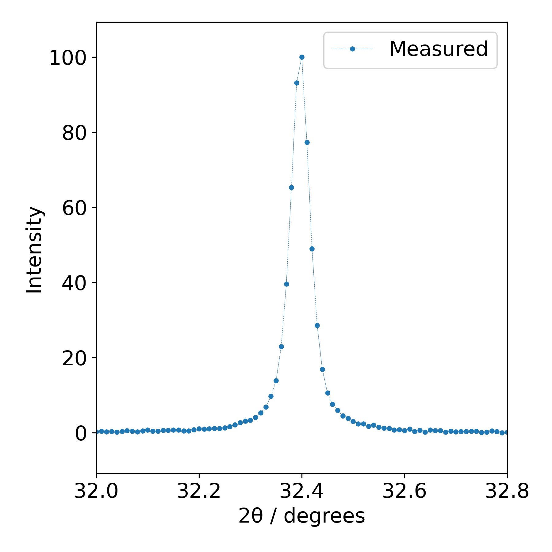
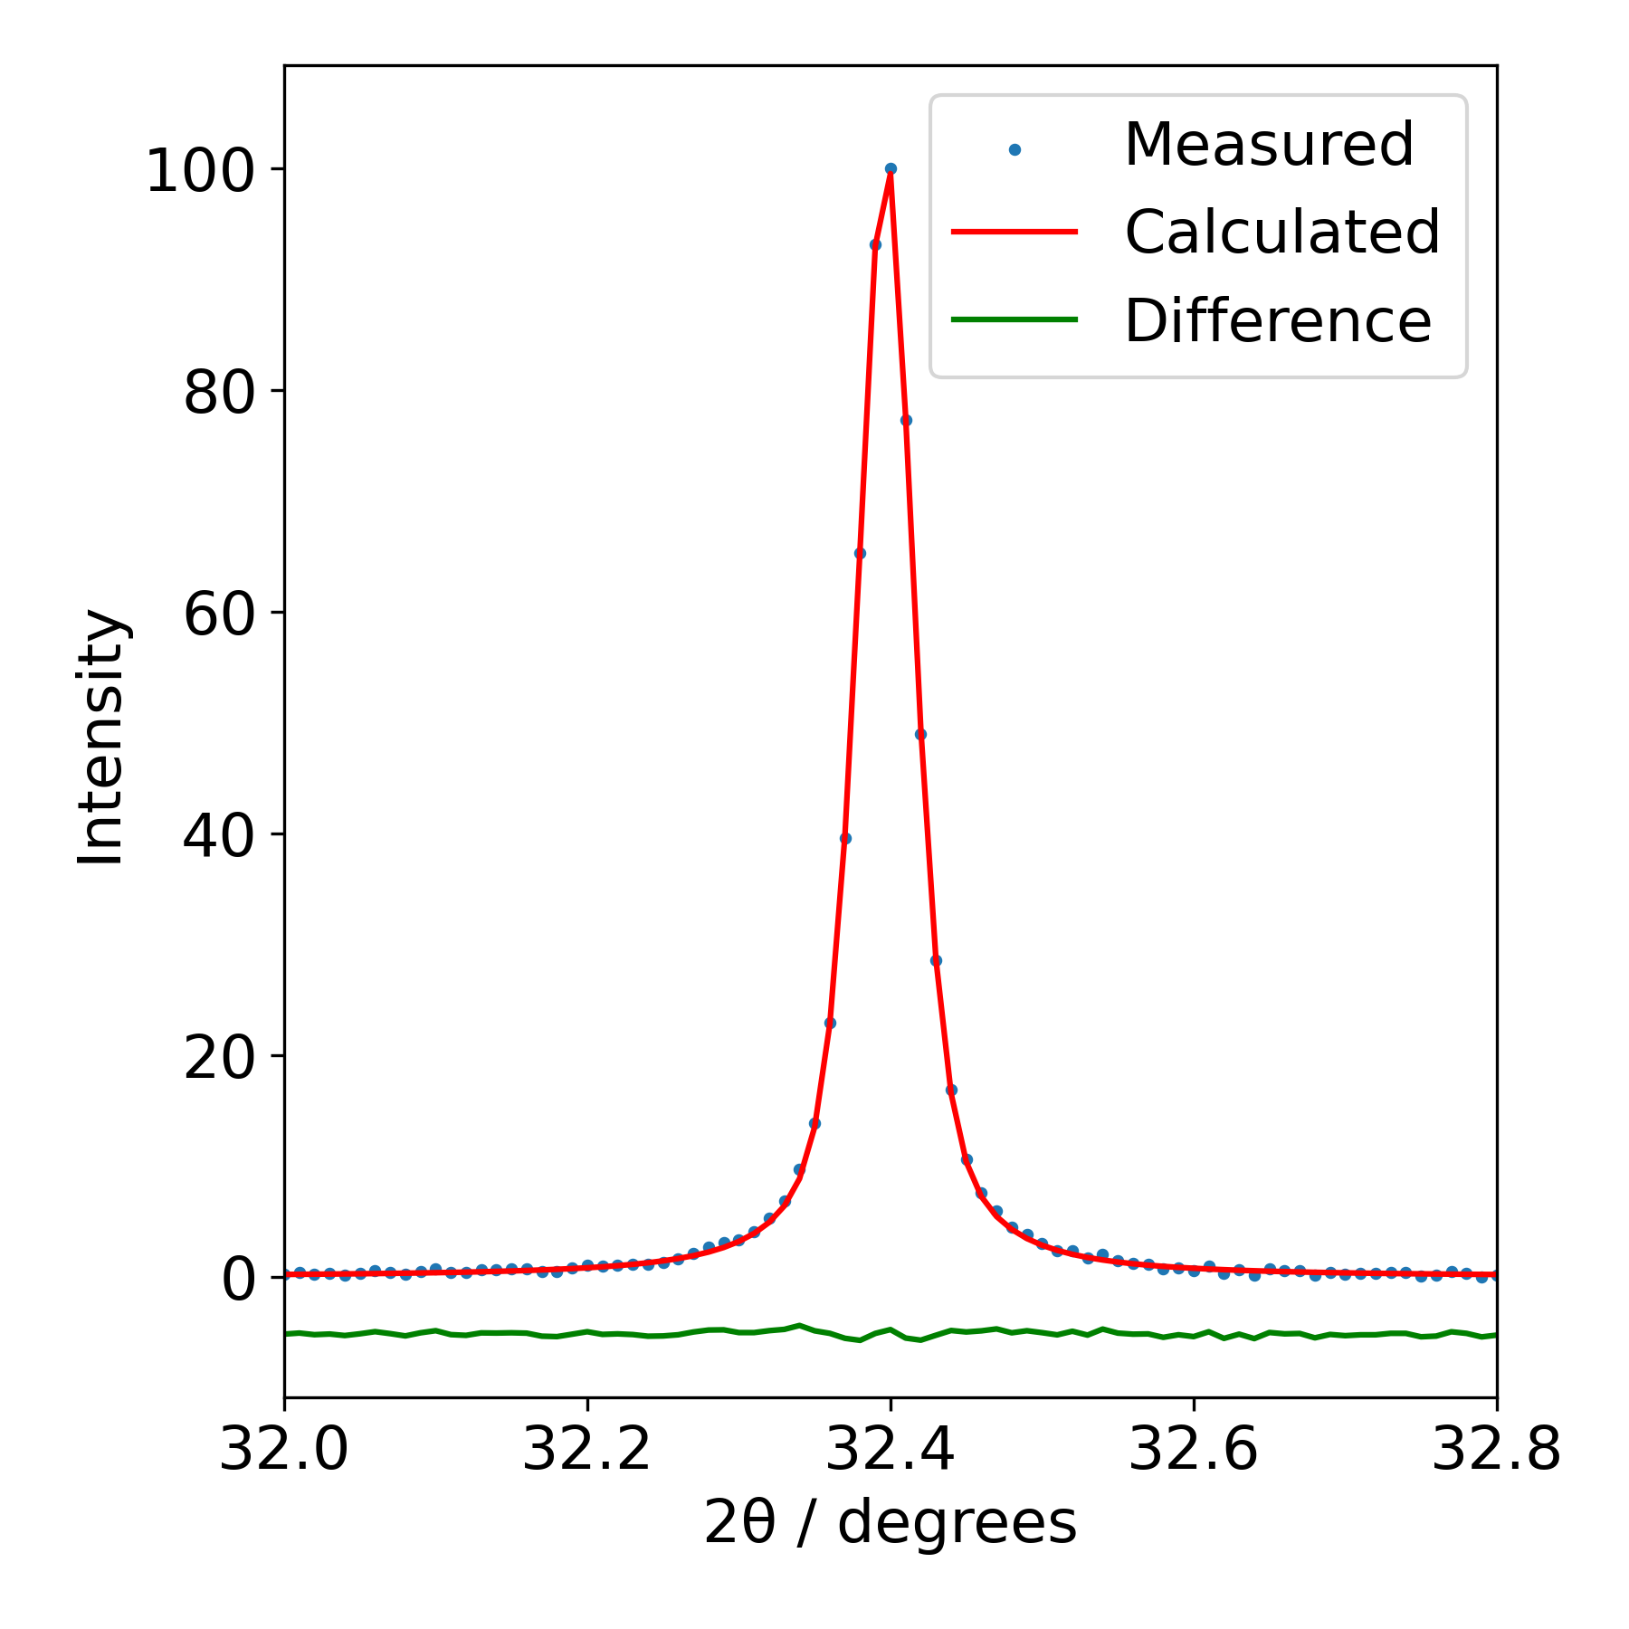
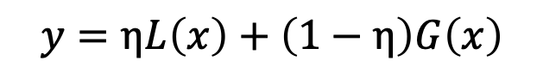
XRD data to structural model
e.g.
Data reliability
(sample, measurement, processing…)
Background model
Diffraction peak shapes
Positions
Areas
Widths
more models!
Assumptions
Interpretation
$$y=ηL\left(x\right)+\left(1−η\right)G\left(x\right)$$
Input
Model
Output

Slide 14
XRD data to structural model
Crystal structure
(another model)
Using only Bragg peak information
Major assumption in crystallography
Perfect volume- and time-averaged model
Positions Areas
Widths
Bragg’s law
Intensities
Structure factors
Thermal effects…
Output
Input
Model

Slide 15
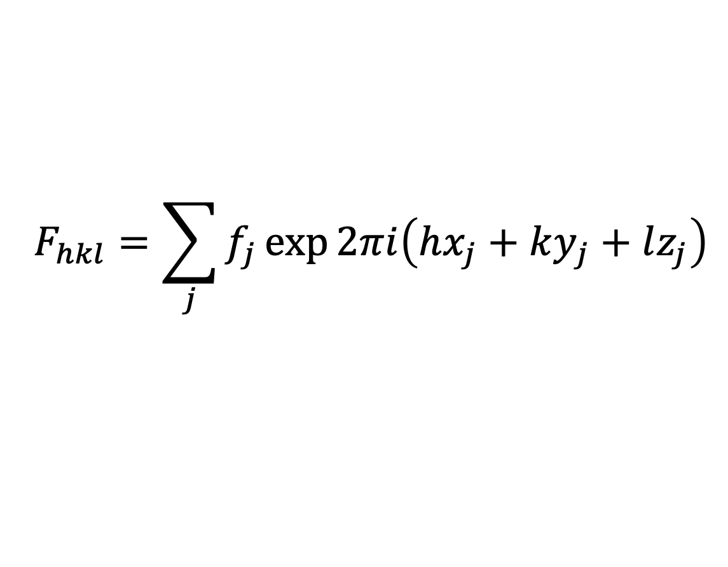
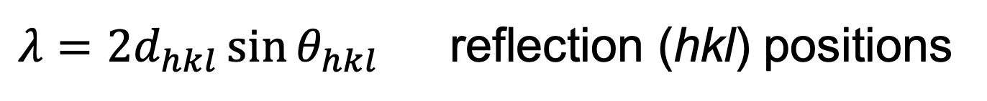
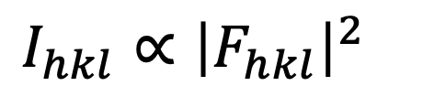
Modelling the diffraction pattern
Bragg’s law
Scattering intensities
$λ=2d_{hkl}\sin{θ_{hkl}}$ reflection (hkl) positions
$$F_{hkl}=\sum_{j}{f_{j}\exp{2πi\left(hx_{j}+ky_{j}+lz_{j}\right)}}$$
f_{j} is the scattering factor for atom j at the position (x_{j},y_{j},z_{j}) in the unit cell. For X-rays, it is related to the atomic number of j
$I_{hkl}∝{\left|F_{hkl}\right|}^{2}$

Slide 16
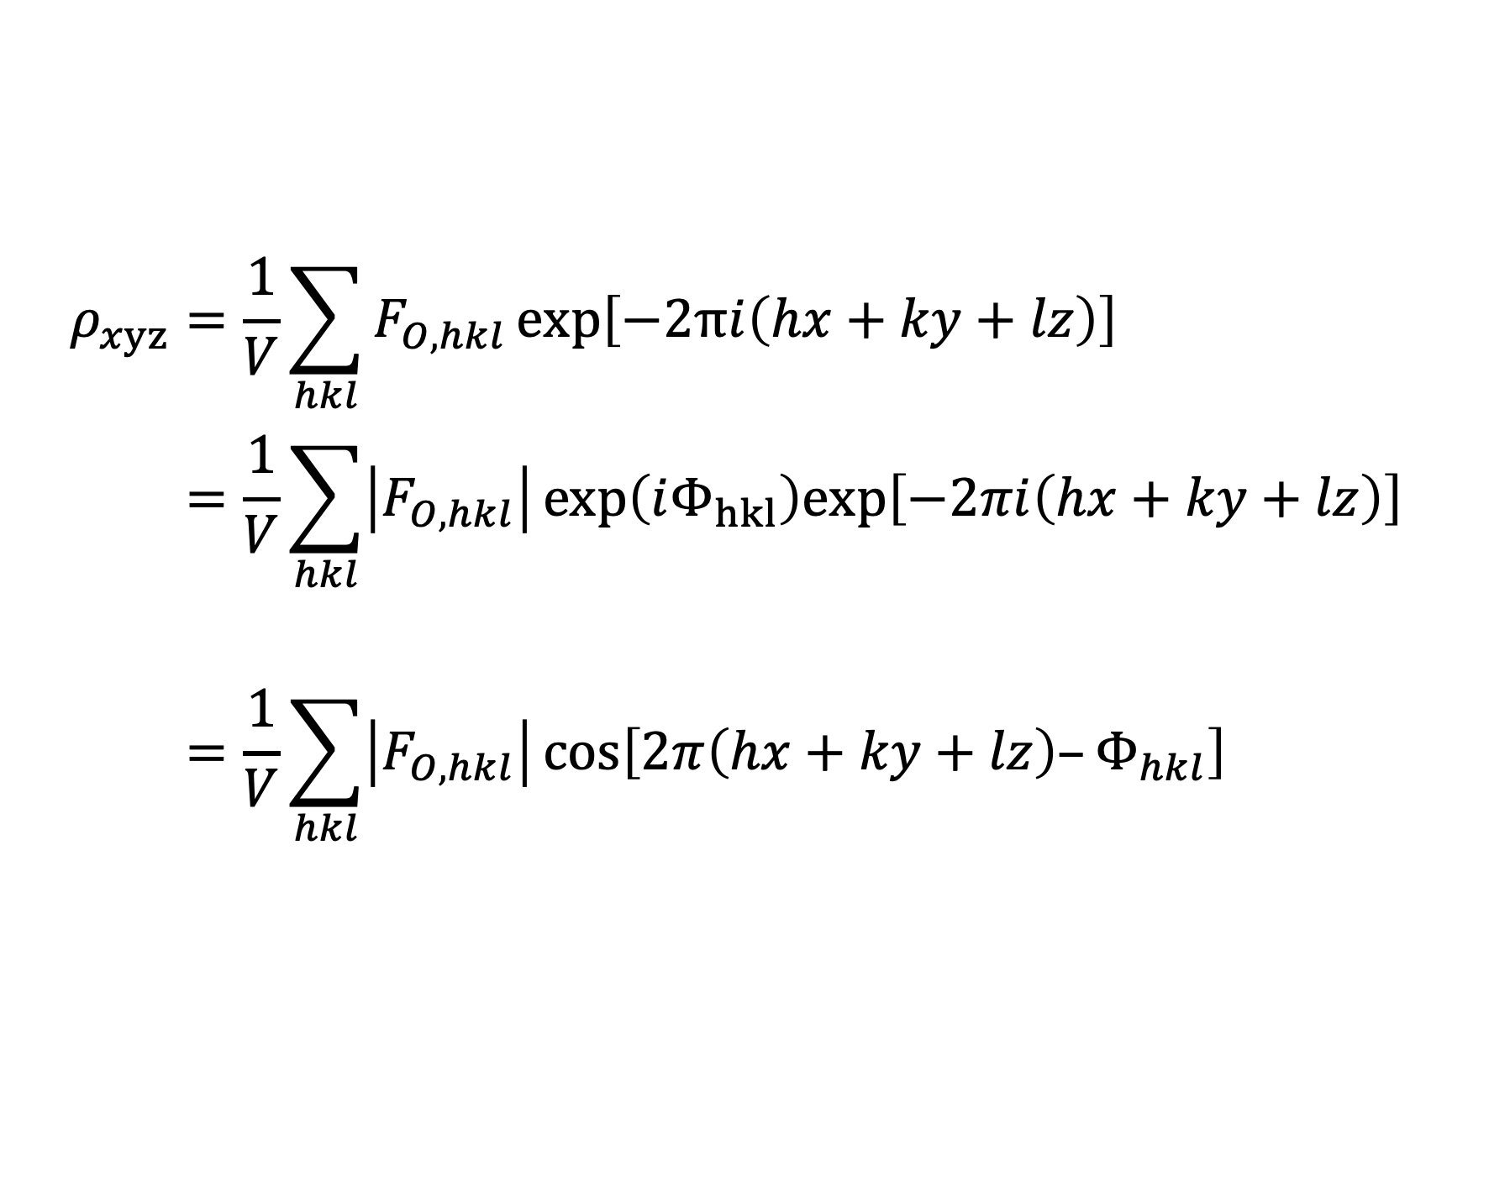
Analysis of diffraction intensities
$$ρ_{xyz}=\frac{1}{V}\sum_{hkl}{F_{O, hkl}}\text{exp}\left[−2πi\left(hx+ky+lz\right)\right] \\ =\frac{1}{V}\sum_{hkl}{\left|F_{O, hkl}\right|}\text{exp}\left(iΦ_{hkl}\right)\text{exp}\left[−2πi\left(hx+ky+lz\right)\right] \\ =\frac{1}{V}\sum_{hkl}{\left|F_{O, hkl}\right|}\text{cos}\left[2π\left(hx+ky+lz\right)–Φ_{hkl}\right]$$
…

Slide 17
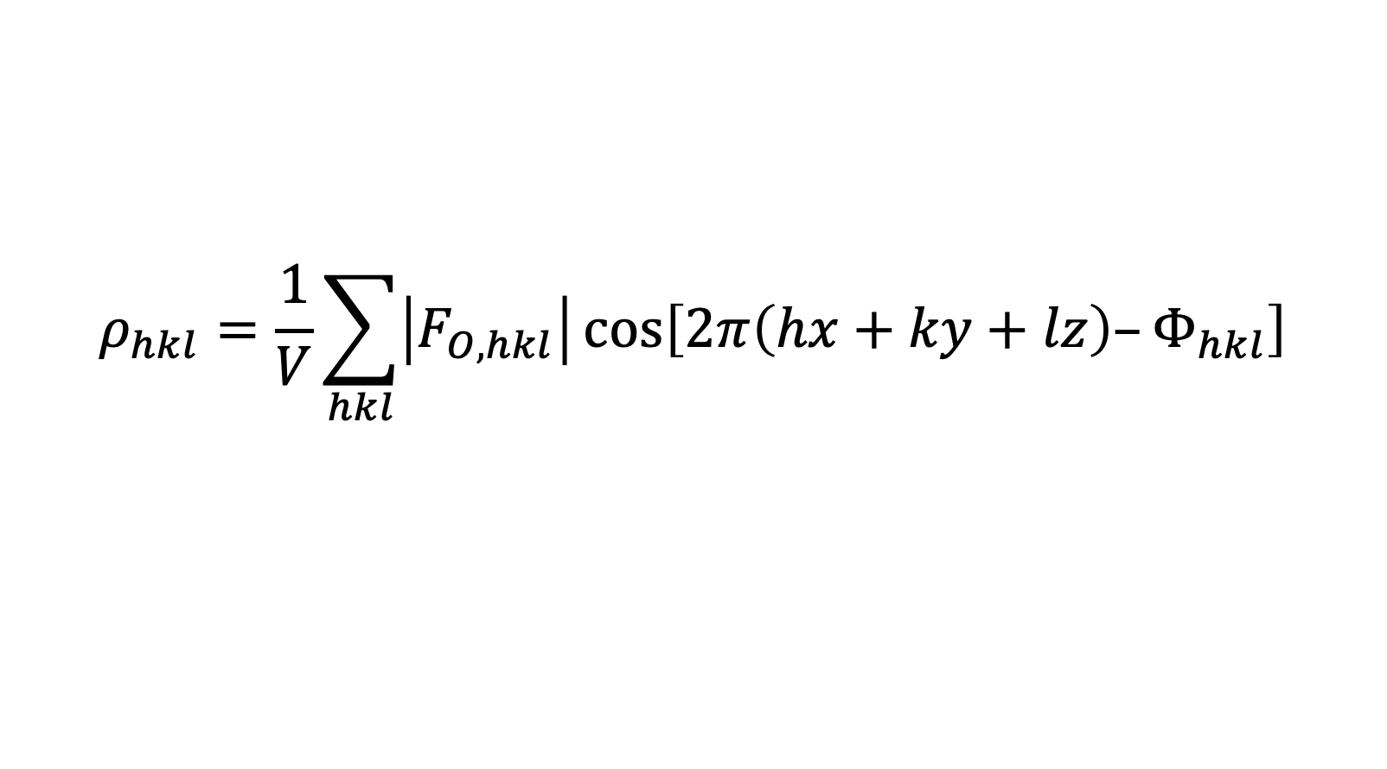
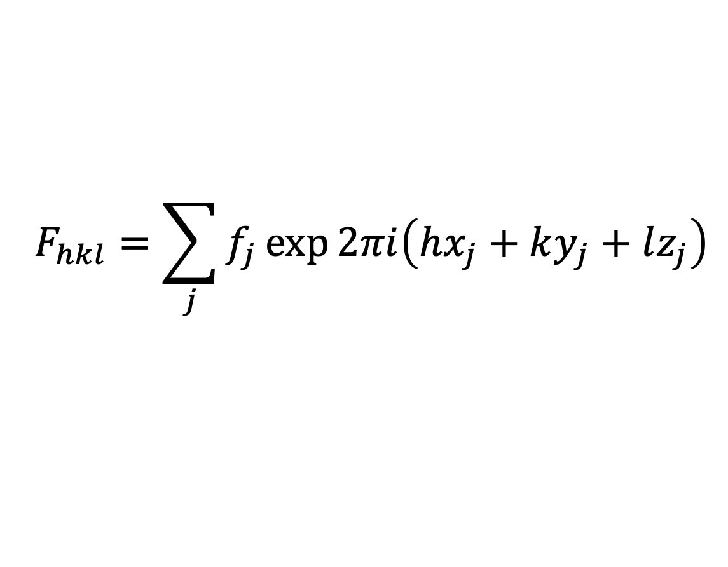
Reciprocal space: diffraction
$$F_{hkl}=\sum_{j}{f_{j}\exp{2πi\left(hx_{j}+ky_{j}+lz_{j}\right)}}$$
Fourier transform
FT
Inverse Fourier transform
(FT)⁻¹
$$ρ_{hkl}=\frac{1}{V}\sum_{hkl}{\left|F_{O, hkl}\right|}\text{cos}\left[2π\left(hx+ky+lz\right)–Φ_{hkl}\right]$$
Real space: crystal structure

Slide 18
Structure determination from PXRD
Reliable intensities I_{hkl} from PXRD profiles can be challenging
Reflections often overlap and cannot be fully resolved
If an approximate model of the crystal structure is available:
Calculate diffraction pattern for the model
Use least square refinement (minimisation) to vary the model parameters to produce a good match for the experimental data
Optimisation of a structural model to fit the whole experimental powder profile: Rietveld refinement

Slide 19
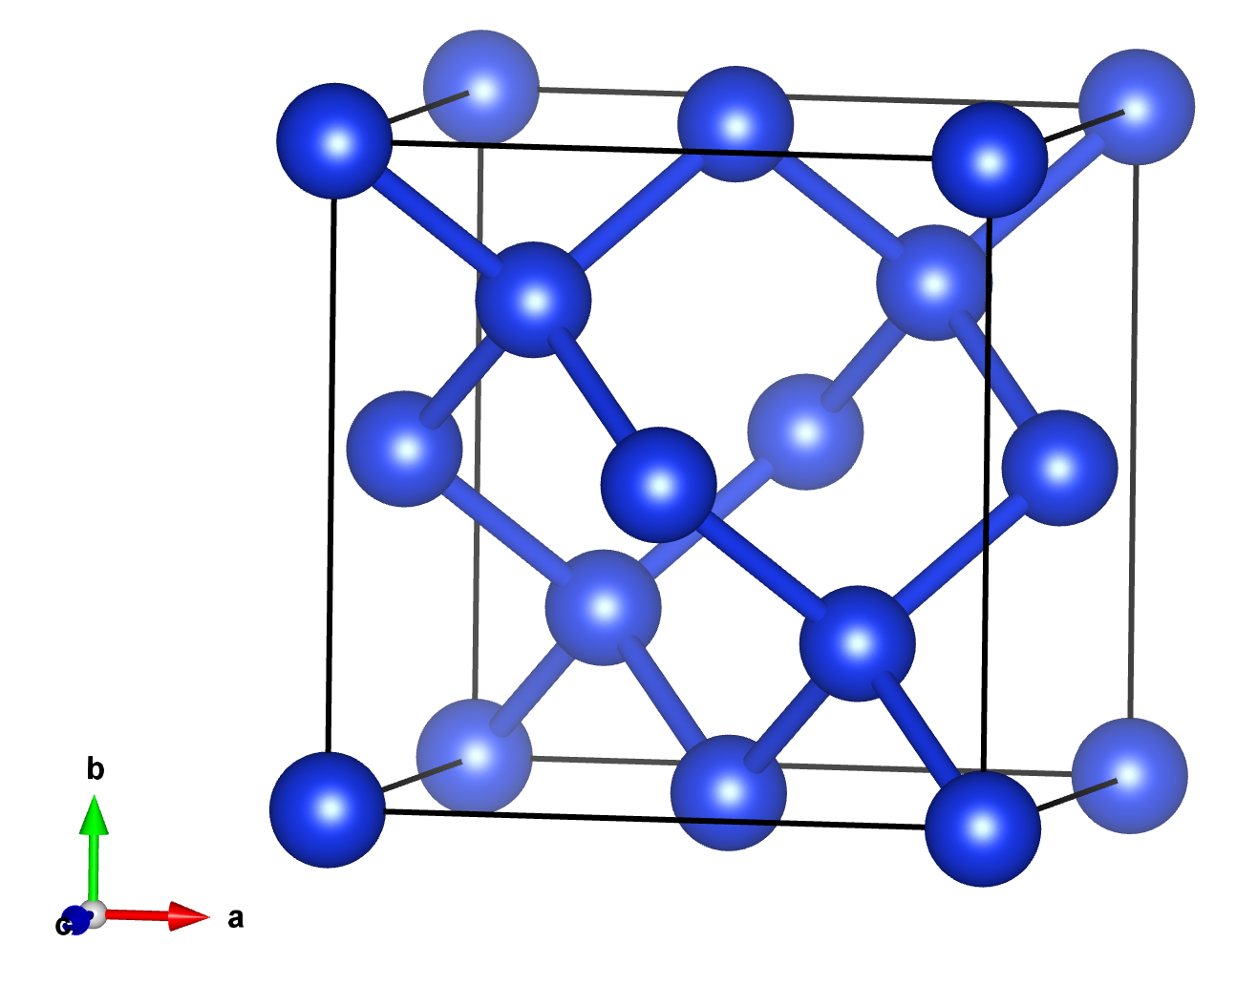
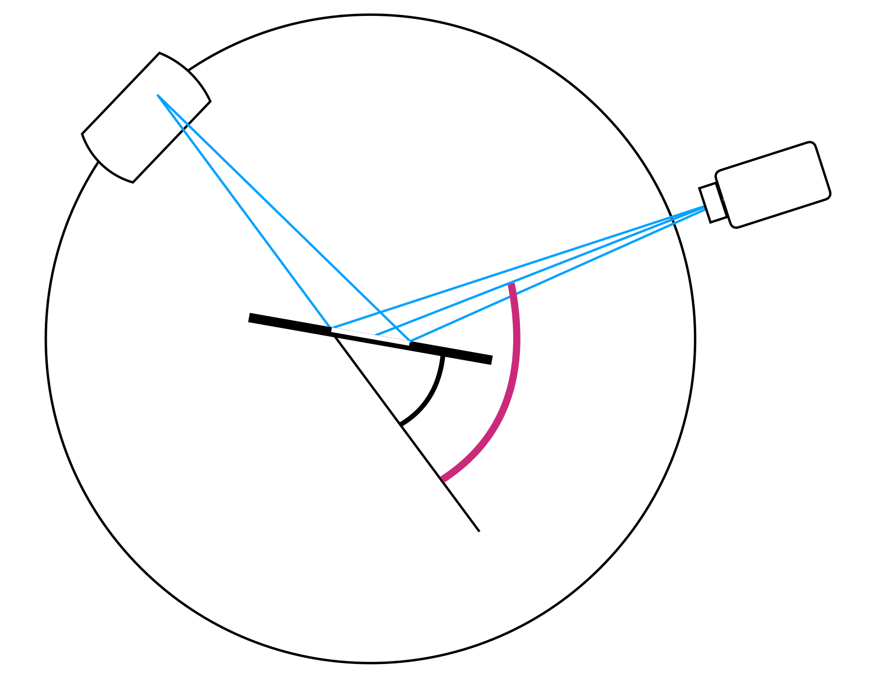
Model refinement
Initial structural model
Unit cell and symmetry (crystal system, lattice centring, space group)
a, b, c, α, β, γ
P, I, F
Atomic contents and positions
For each atom: species (f_{j}) position x, y, z atomic displacement b
Experimental model
Diffractometer
Data collection
↔︎ Positions of reflections︎
→ Systematic absences
→ Intensities
Sample model
Crystal size
Sample format
↔ Intensities
↔ Peak positions ↔ peak shapes

Slide 20
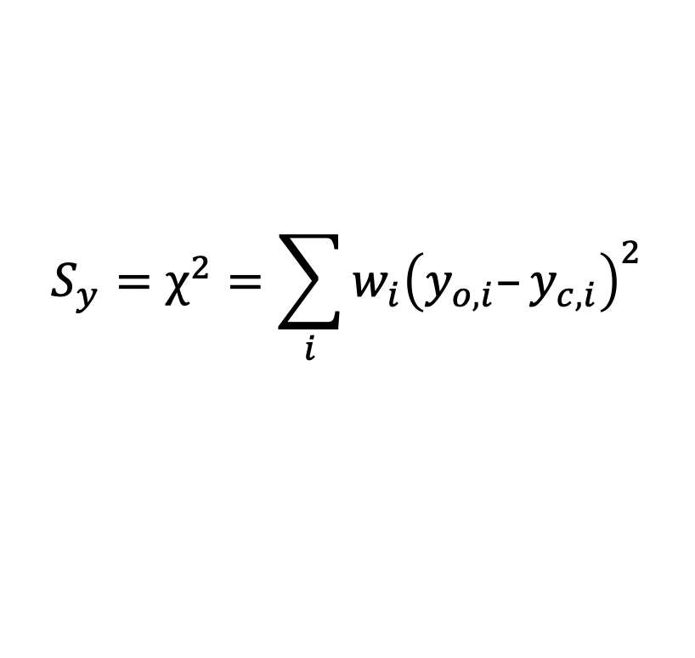
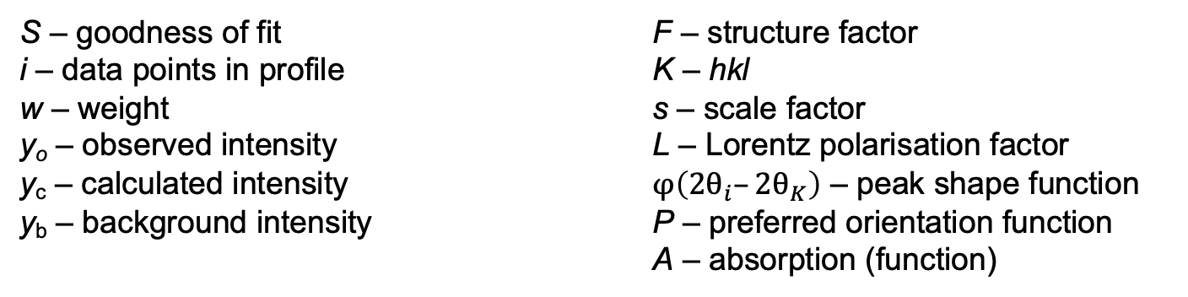
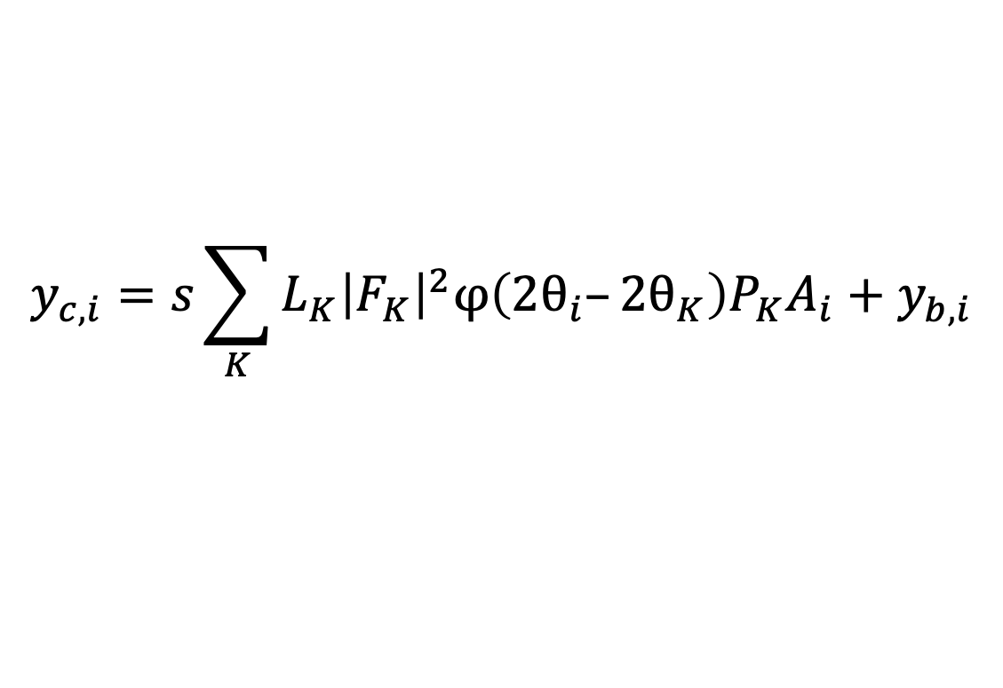
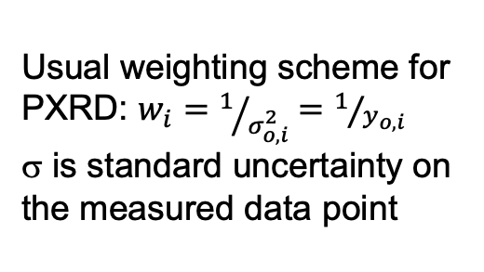
Least squares
minimisation
$$S_{y}=χ^{2}=\sum_{i}{w_{i}{\left(y_{o,i}–y_{c,i}\right)}^{2}}$$
Usual weighting scheme for PXRD: $w_{i}=1/{σ_{o, i}^{2}}=1/{y_{o,i}}$
σ is standard uncertainty on the measured data point
$$y_{c,i}=s\sum_{K}{L_{K}{\left|F_{K}\right|}^{2}φ\left(2θ_{i}–2θ_{K}\right)P_{K}A_{i}+y_{b,i}}$$
where
S – goodness of fit F – structure factor
i – data points in profile K – hkl
w – weight s – scale factor
y_{o} – observed intensity L – Lorentz polarisation factor
y_{c} – calculated intensity $φ\left(2θ_{i}–2θ_{K}\right)$ – peak shape function y_{b} – background intensity P – preferred orientation function
A – absorption (function)

Slide 21
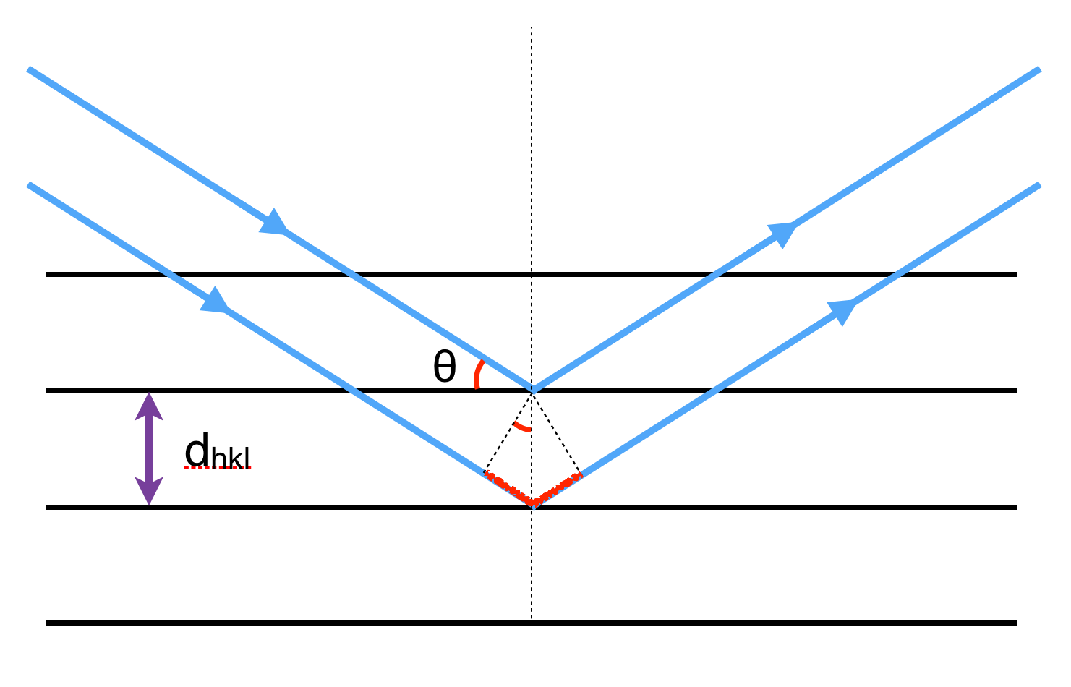
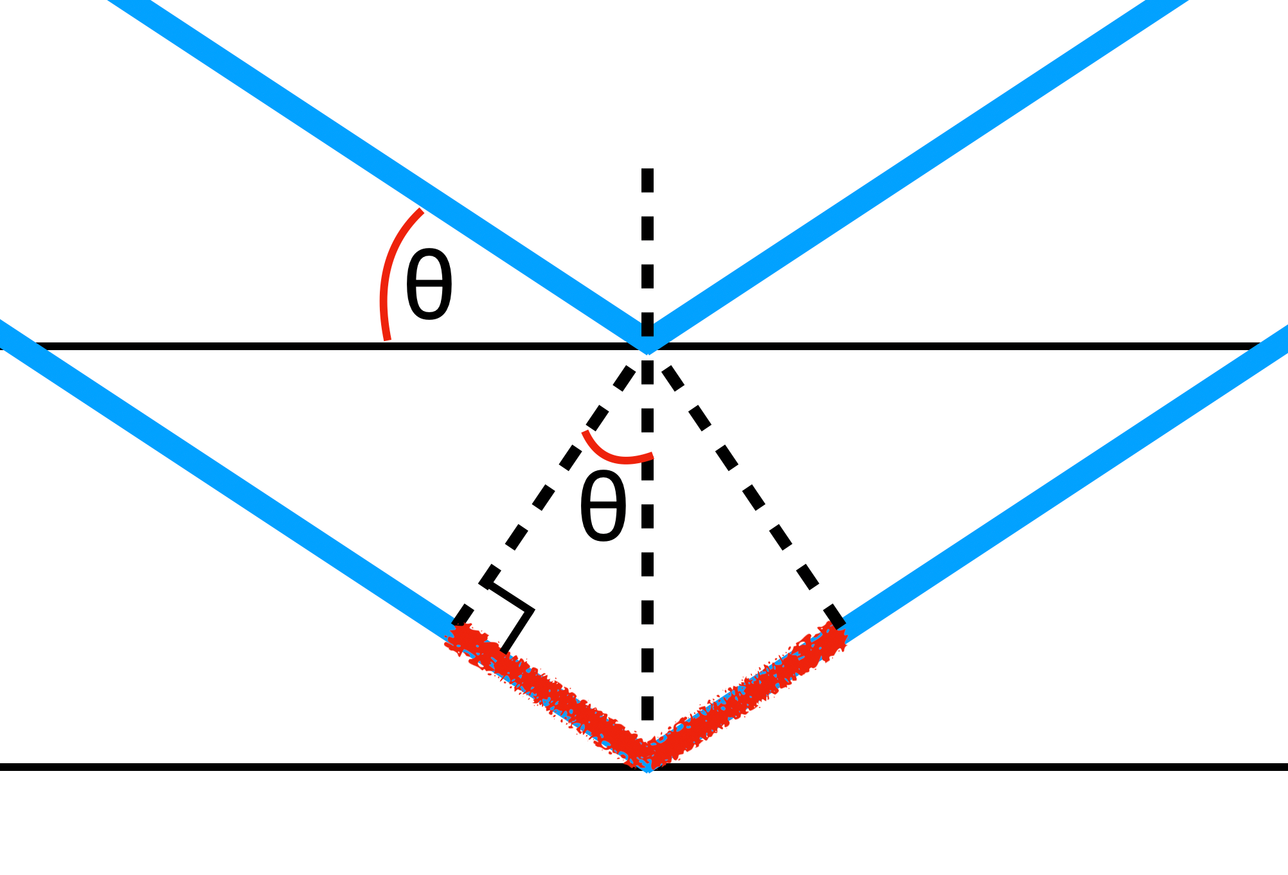
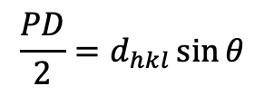
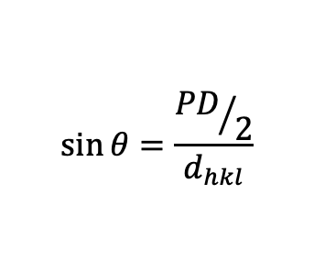
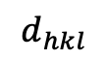
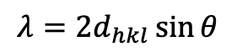
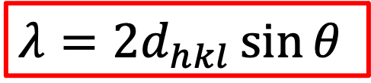
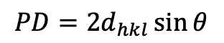
Bragg’s law
Remember: For constructive interference, PD = nλ
For our purposes, n = 1
Parallel X-rays
wavelength λ
$$λ=2d_{hkl}\sin{θ}$$
$$\sin{θ}=\frac{{PD}/2}{d_{hkl}}$$
$$\frac{PD}{2}=d_{hkl}\sin{θ}$$
$$PD=2d_{hkl}\sin{θ}$$
path difference
$$d_{hkl}$$
For constructive interference, PD = nλ
Crystal planes
(hkl)
$$λ=2d_{hkl}\sin{θ}$$
PD

Slide 22
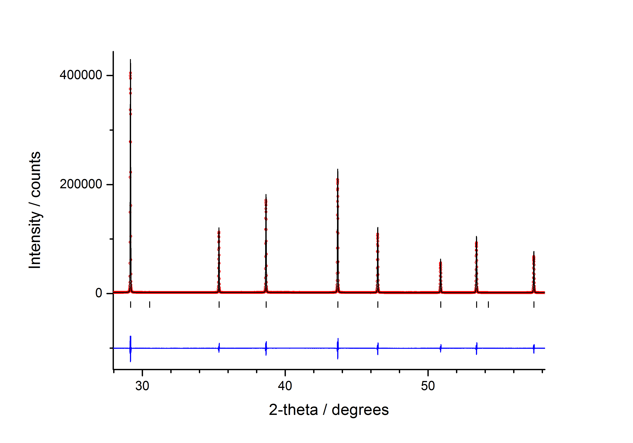

experimental dataset calculated pattern difference reflection (hkl) position
Silicon crystal structure
Pat Woodward’s (OSU)
Rietveld refinement

Slide 23
Accessing structural data
Crystal structures
BYO – determined from diffraction
ICSD
CSD
COD
PDB, minerals, incommensurate
Materials Project
PCOD
OQMD
Diffraction data
ICDD (PDF-4/5+, etc.)
P2D2 (from PCOD)
BYO
– collect data
– from crystal structures
Notes:
105546

Slide 24
https://github.com/rsc-solid-data/data_diffn_crystals

Slide 25
Comparing XRD profiles
Be aware of where the cifs are from
Experimental conditions
Comparability of molecular simulations
Be aware of where the experimental data is from
Experimental conditions
Sample compositions (guest inclusion, compositional variation)
Sample effects (size, preferred orientation, absorption, phase purity)
Instrumental considerations (broadening, Lp, optics)
Structural effects (order/disorder, symmetry, phase transitions)

Slide 26
Comparing XRD profiles
Try the unit cell and space group
Structureless refinement – no atoms, arbitrary intensities
Le Bail or Pawley
Try a refinement
Rietveld refinement is local minimisation
Need a good starting model

Slide 27
Some extra resources
Fundamentals of Powder Diffraction and Structural Characterization of Materials, Springer US, Boston, MA, 2009.
B. H. Toby, R factors in Rietveld analysis: How good is good enough?, Powder Diffr., 2006, 21, 67–70.
L. B. McCusker, R. B. Von Dreele, D. E. Cox, D. Louër and P. Scardi, Rietveld refinement guidelines, J Appl Cryst, 1999, 32, 36–50.
J. H. O’Donnell, R. B. Von Dreele, M. K. Y. Chan and B. H. Toby, A scripting interface for GSAS-II, J Appl Cryst, 2018, 51, 1244–1250.

